Slide 1
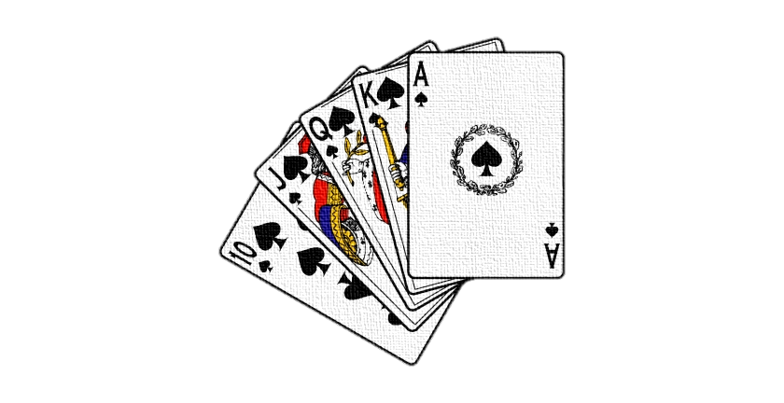
Playing Cards 24
Ayush, Neha, Luc, Adam

Slide 2
What does the game include?
The user will see the graphical interface for the game.
There will be multiple buttons and cards displayed such as:
Find a solution(button)
Refresh(button)
Verify(button)
Four random playing cards
Text field for user input

Slide 3
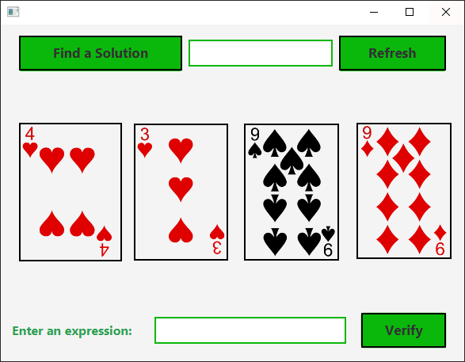
What does the game look like?

Slide 4
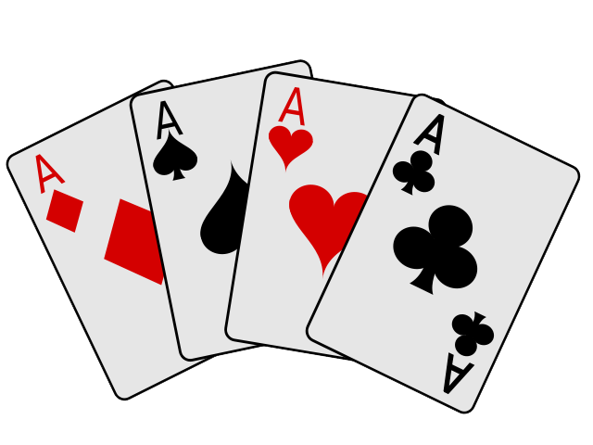

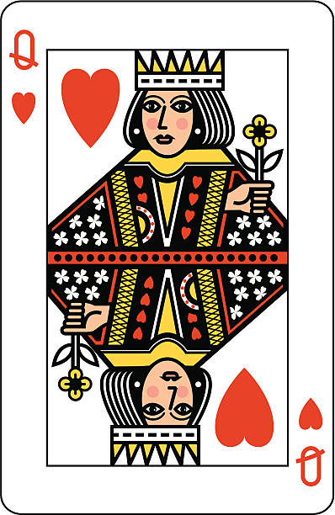
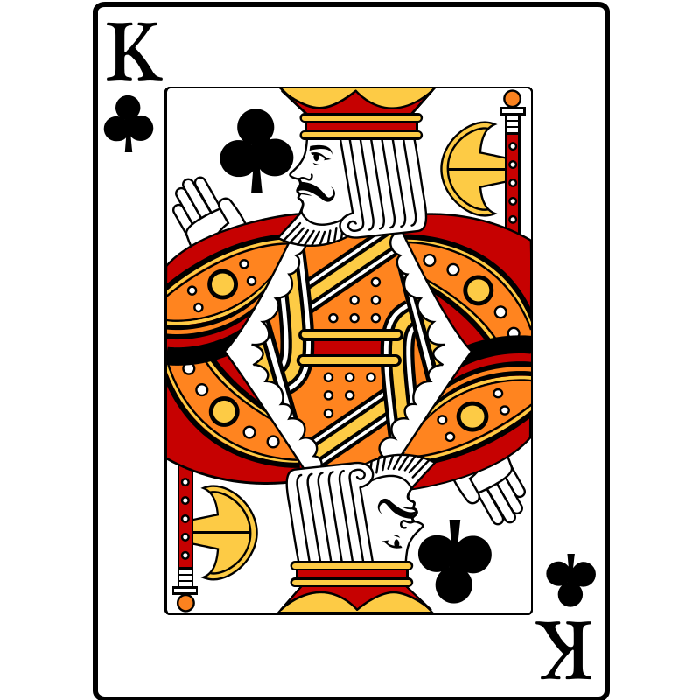
Card values guide
The cards are represented by:
A)Their numbers (2-10)
B) Ace is one
C) Jack is 11
D) Queen is 12
E) King is 13

Slide 5
How to play the game?
Step 1: The user will be shown four random playing cards when they run the application.
Step 2: User will refer to the card values guide.
Step 3: User will try to use any arithmetic operations to create a formula to make the four random card’s numbers equal to 24.
Example: (6+6*12/6)
Step 4: If the user is unable to create the formula for the cards to equal to 24. Then user will hit Refresh button to shuffle the cards again.

Slide 6
Game Rules
Enter an expression that uses the four numbers from the four selected cards.
Each number must be used once and only once.
You can use the four arithmetic operators (addition, subtraction, multiplication and division) and parenthesis in the expression.
The expression must evaluate to 24.
After entering the expression, click the verify button to validate whether the numbers in the expression are currently selected and whether the result of the expression is correct.
Display the verification in a dialog box.
Note that such an expression might not exist.
In that case, click the Refresh button to get another set of four cards.

Slide 7
Thank you
Ayush, Neha, Luc, Adam

